Slide 1

Online Taxi
Booking
-Presented by Group No. 4

Slide 2
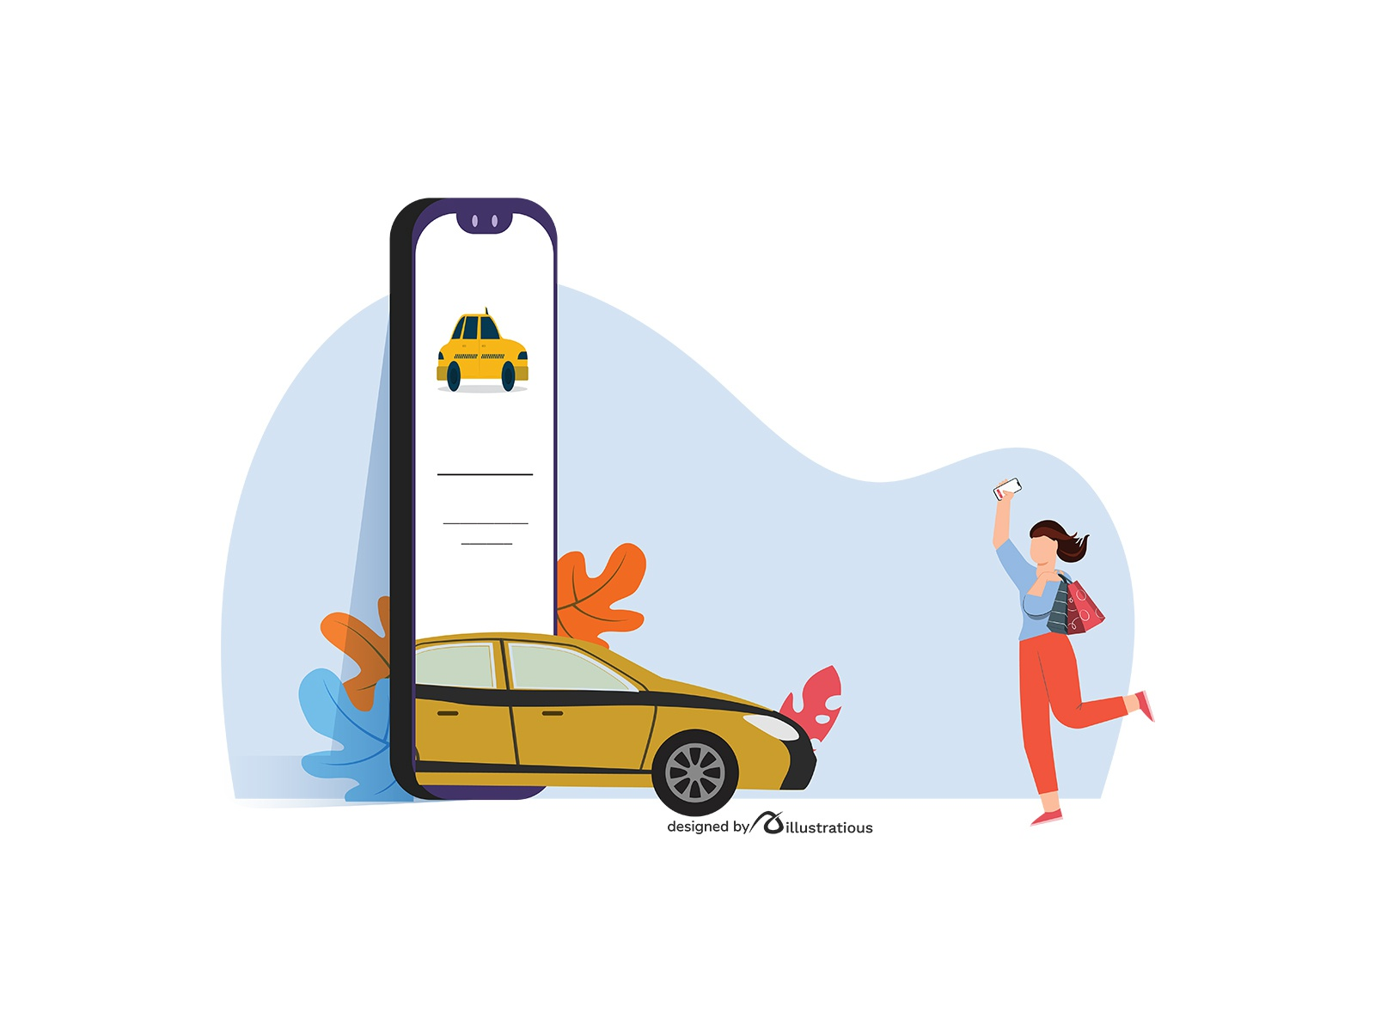
Introduction:
An online car rental system for transportation.
Quick and hassle-free bookings just by using a software.
Offers mobility solutions by connecting customers and drivers.
Wide range of Cabs like, SUVs, Sedans, Hatchbacks, etc.

Slide 3
Group Members:
Rupesh Sai Manikanta T
Sahil Jain
Pooja Varghat
Rachel Gajelli
Anisha Gothi
Himanshu Singh

Slide 4

Purpose:
To book cabs, plan and schedule a journey online.
To manage employees and bookings.
Manages daily and monthly logs and weekly rosters.

Slide 5
Technologies used:
Tool
Visual Studio 2019
Framework
.Net Framework 4.7.2
Language
C#
Data Access Technology
ADO. Net
FrontEnd
WPF
Database
SQL Server 2014

Slide 6
Modules
User - Pooja Varghat & Anisha Gothi
Admin - Rupesh Sai Manikanta T & Rachel Gajelli
Employee - Sahil Jain & Rupesh Sai Manikanta T
Customer - Anisha, Pooja, Himanshu Singh
Booking - Rupesh Sai Manikanta T & Sahil Jain
EmployeeRoster - Rachel Gajelli & Pooja Varghat

Slide 7
Limitations & Assumptions:
Limitations:
Window navigation unavailable.
No validation for Email Id while registration.
The option of “Forgot Password?” is unavailable.
No constraint for time slot selection.

Slide 8
Assumptions:
Employee work hours must not be changed.
.Employee cannot edit his Roster.
Customer will select only the future time.

Slide 9
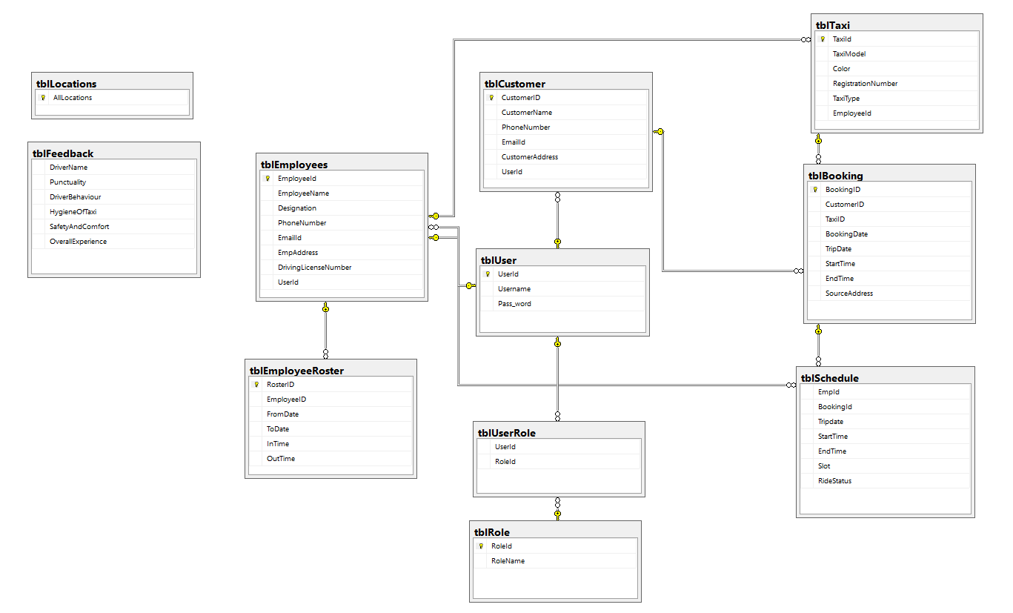
Database
Diagram

Slide 10
Stored Procedures
2
tblRole
3
tblUserRole
tblEmployeeRoster
usp_GetUserId
usp_ValidateUser
usp_ChangePassword
usp_CreateNewEmployeeRoster
usp_GetDailyLogs
usp_GetMonthlyLogs
usp_GetAvailableEmployee
usp_GetRosterByEmp
usp_GetWeeklyRosters
tblUser
9
tblLocation
1
6
usp_CreateTaxi
usp_GetTaxiById
usp_GetTaxiByType
tblCustomer
usp_CreateNewCustomer
usp_GetAllCustomer
7
tblBooking
usp_CreateBooking
usp_GetBookingsByEmpId
usp_CompleteRide
10
tblSchedule
5
4
tblEmployee
usp_CreateSchedule
usp_CreateAdmin
usp_CreateEmployee
usp_GetAllEmployees
usp_GetEmployeeName
usp_GetTaxiById
usp_GetTaxiByType
8
tblTaxi
11
tblFeedback
usp_SaveFeedback
usp_GetAllFeedback

Slide 11
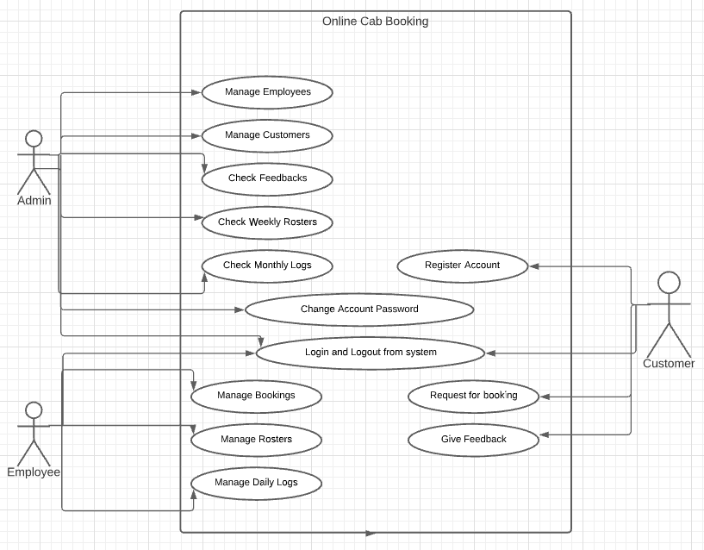
Use Case Diagram

Slide 12
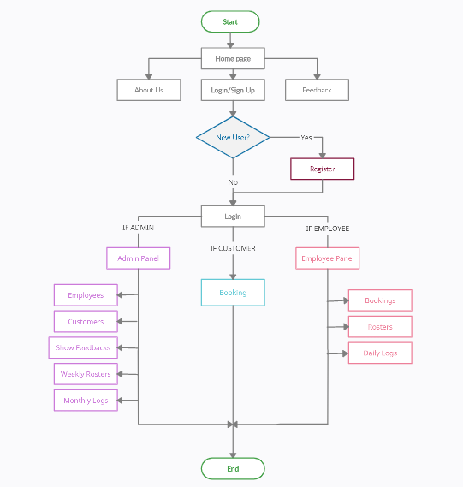
WorkFlow

Slide 13
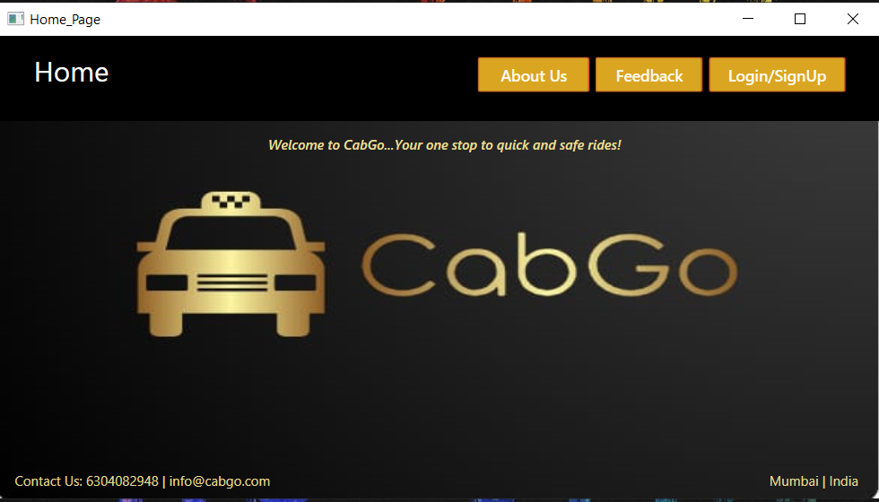
Home Page

Slide 14
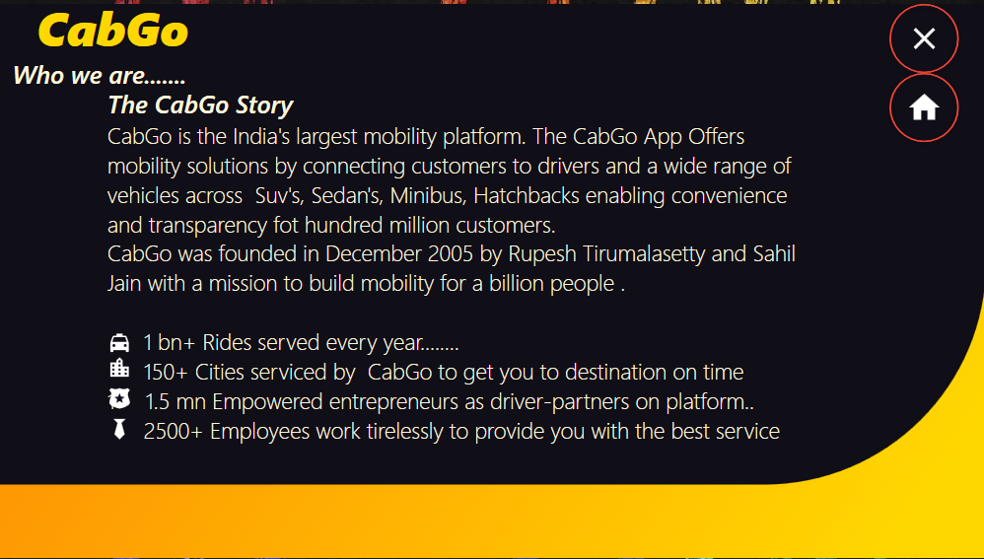
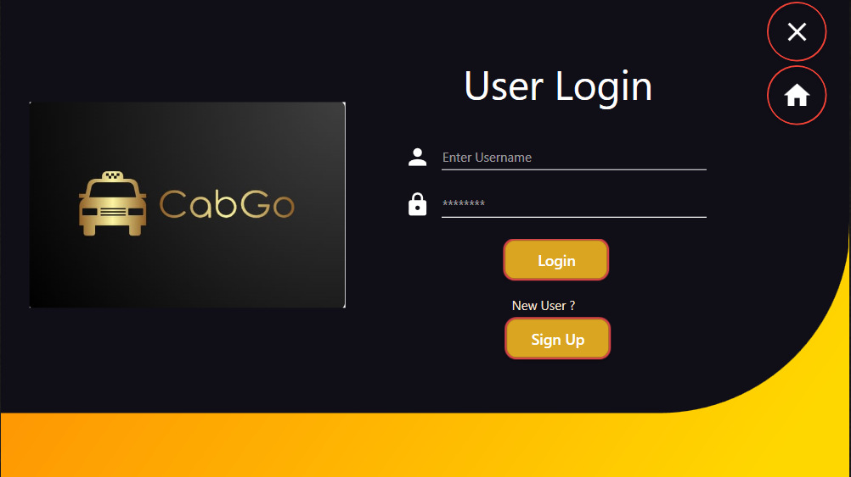
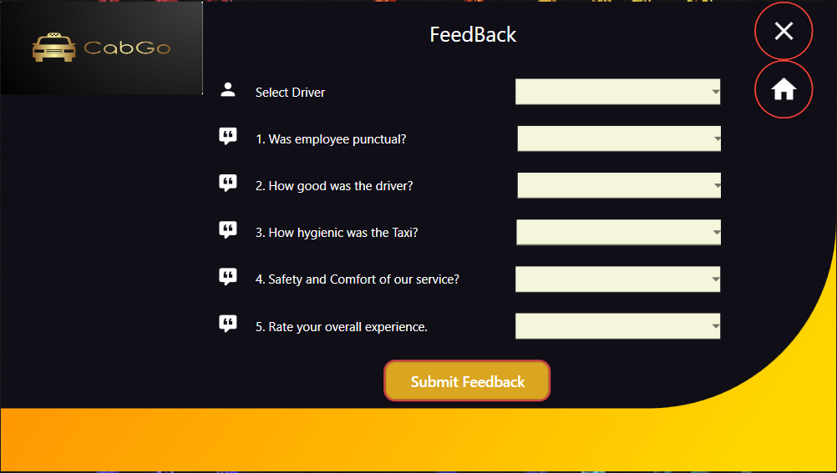

Slide 15
HomePage -> Login Page

Slide 16
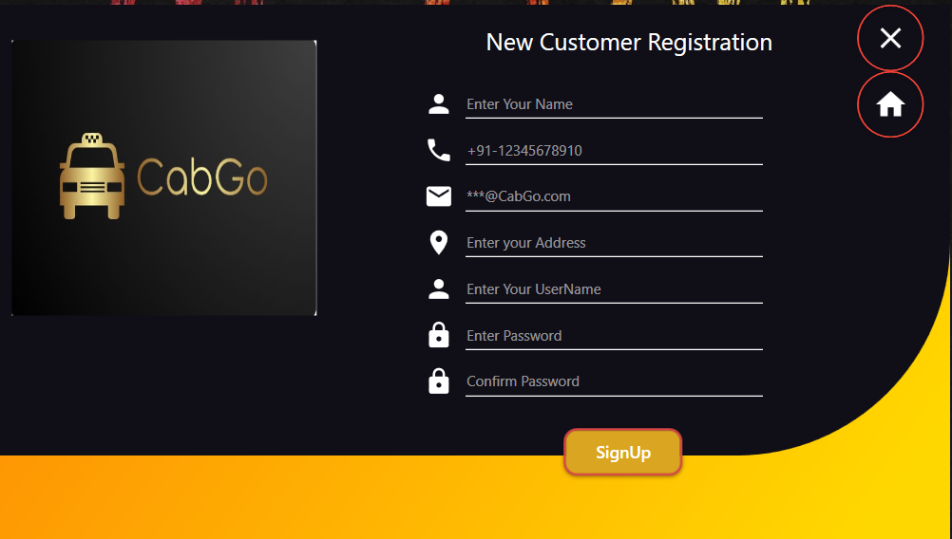
Login Page(New Customer) -> Signup Page

Slide 17
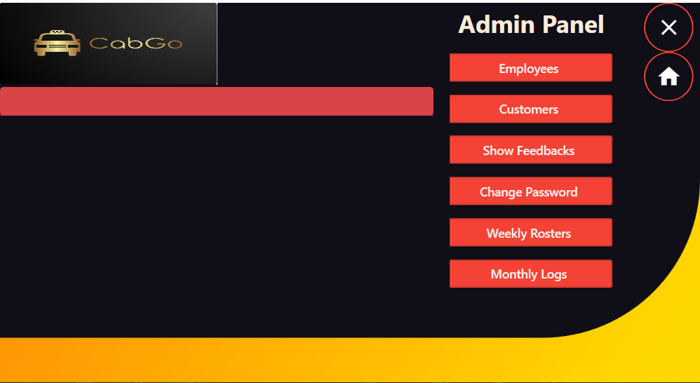
Login Page(Admin) -> Admin Panel

Slide 18
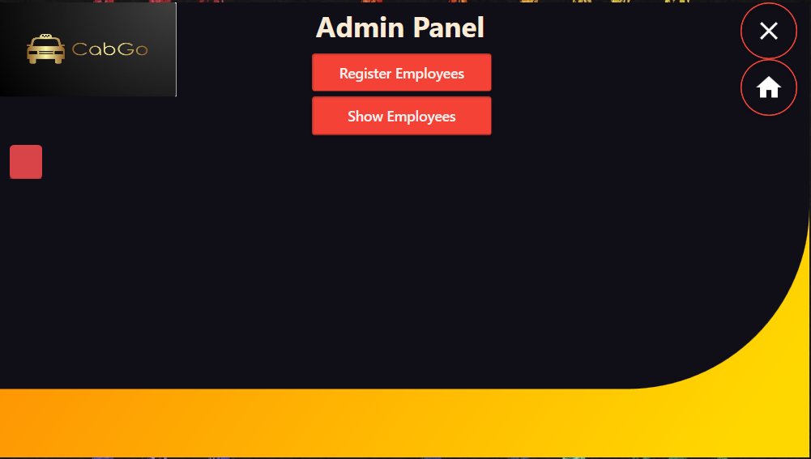
Login Page(Admin) -> Admin Panel->Employees

Slide 19
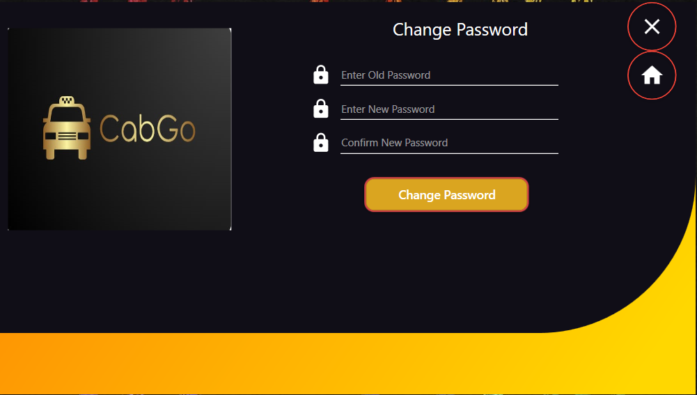
Login Page(Admin) -> Admin Panel->Change Password

Slide 20
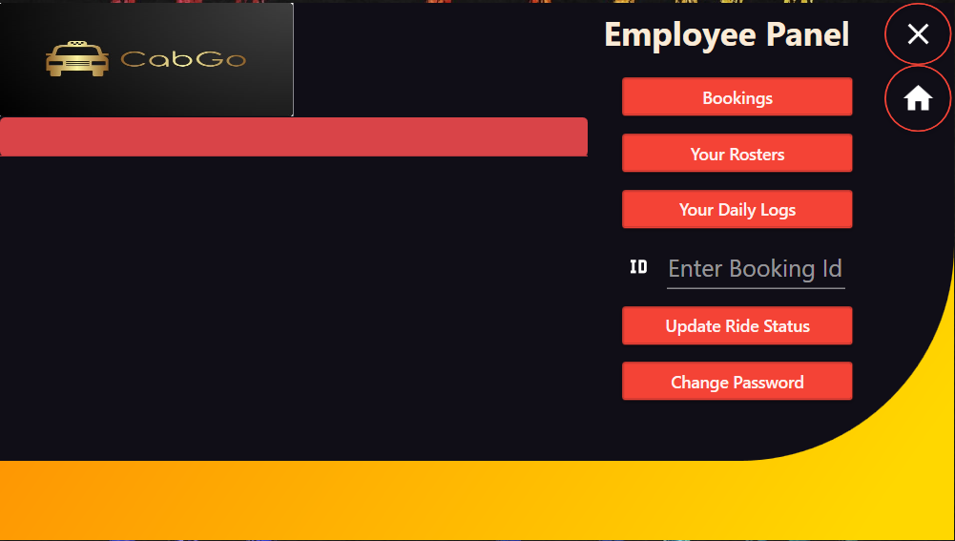
Login Page(Employee) -> Employee Panel

Slide 21
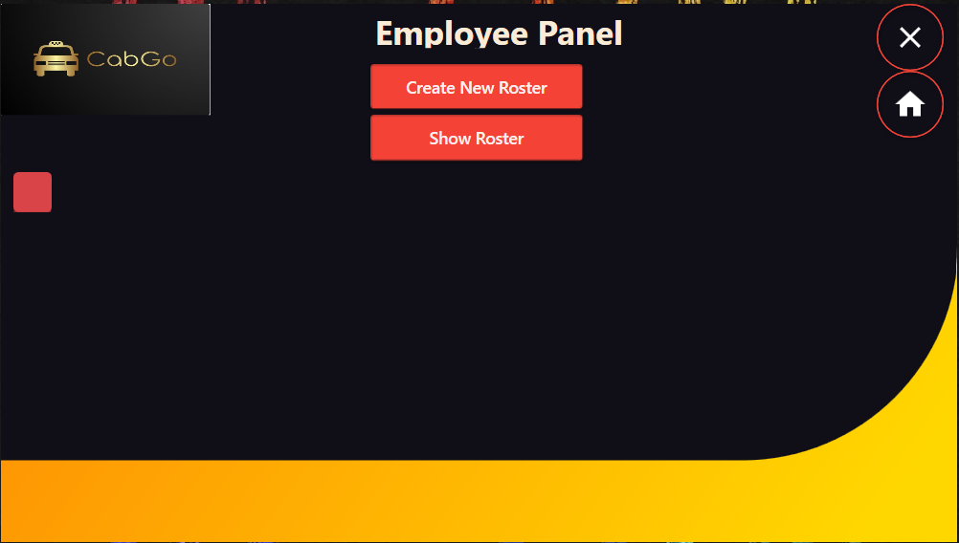
Login Page(Employee) -> Employee Panel-> Your Roster

Slide 22
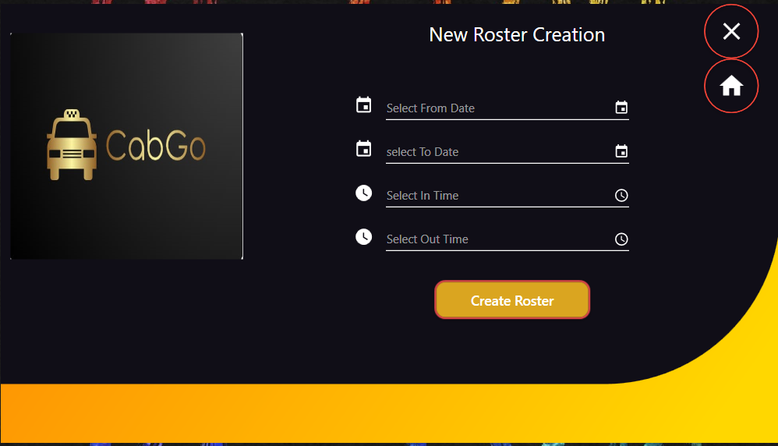
Employee Panel-> Your Roster-> Create New Roster

Slide 23
Login Page(Employee) -> Employee Panel->Change Password

Slide 24
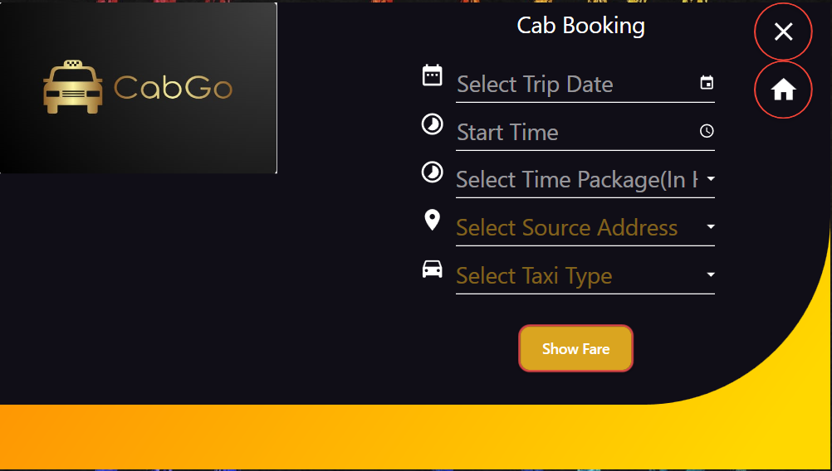
Login Page(Customer) -> Cab Booking

Slide 25
Experience
Working on this project gave us very good exposure of SQL Server, ADO.NET and Visual Studio.
We learnt the importance of each layer used in the project and their inter connectivity.
We learned to follow proper casing and conventions while writing a code

Slide 26
Credits
Special thanks to our trainer Pratibha Reddy for her guidance throughout our project.

Slide 27
Thank You!

